Slide 1
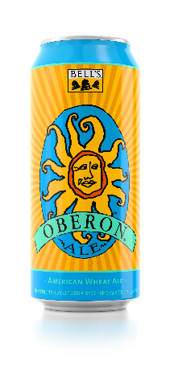
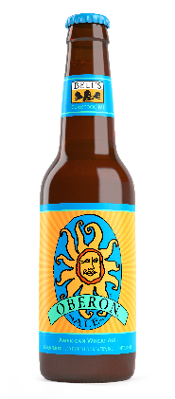
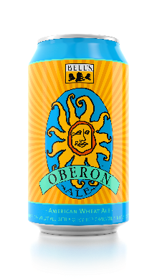
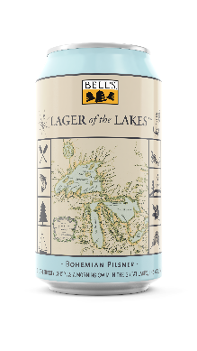
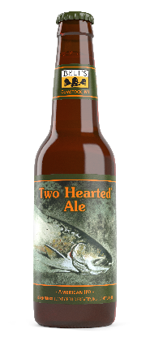
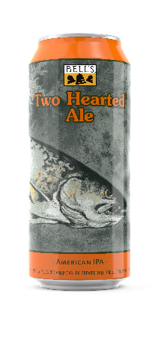
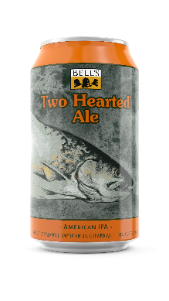
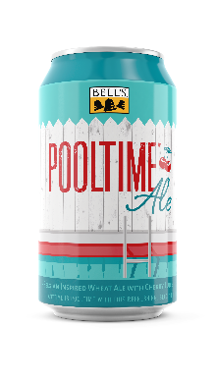
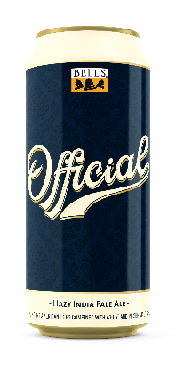
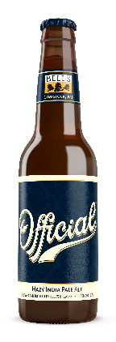
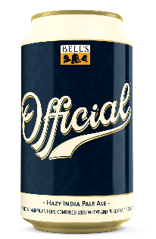
Oberon Ale
American Wheat Ale | 5.8%
An American Wheat Ale with a spicy hop character, mildly fruity aromas and the color and scent of a sunny afternoon.
Pair with Oranges, seafood, bread pudding, fennel
Lager of the Lakes
Bohemian Pilsner | 5%
Golden lager in the tradition of Czech Pilsners. Crisp bitterness and an herbal hop aroma are complemented by a nice malt presence.
Pair with Blueberries, parsley, blackberries, lemon, shellfish
Two Hearted Ale
American IPA | 7%
100% Centennial hops. Bursting with hop aromas ranging from
pine to grapefruit, perfectly balanced with a malt backbone.
Pair with Grapefruit, cilantro, bleu cheese, burgers
Pooltime Ale
Belgian Wheat ale with tart cherries | 5%
A refreshing Belgian-inspired Wheat Ale with light clove notes. Cherries add a subtle tartness and bright counterpoint to other flavors.
Pair with Cherries, pork, jalapenos
Official
Hazy IPA | 6.4%
Double dry-hopped resulting in complex peach, stone fruit and tropical notes with a dry finish and balanced bitterness.
Pair with Peaches, roasted chicken, garlic bread, pickled fruits, white chocolate
Notes:
Two Hearted, Seasonal, Xmas
From Kroger - Sales Data, food pantry

